Slide 1
How to Build an Industry Cost Profile (ICP) for a product in the Philippines
Select the Industry Code Based on the Supplier’s Business and Product
Step 2
Identify Data Sources for Financial and Manufacturing Information Related to Industry Code
Step 3
Use Financial Data to Calculate Ratios for COGS, PBT, GSA & Other Expenses
Step 4
Use Manufacturing Data to Calculate Ratios for DM, DL, and MOH
Step 1

Slide 2
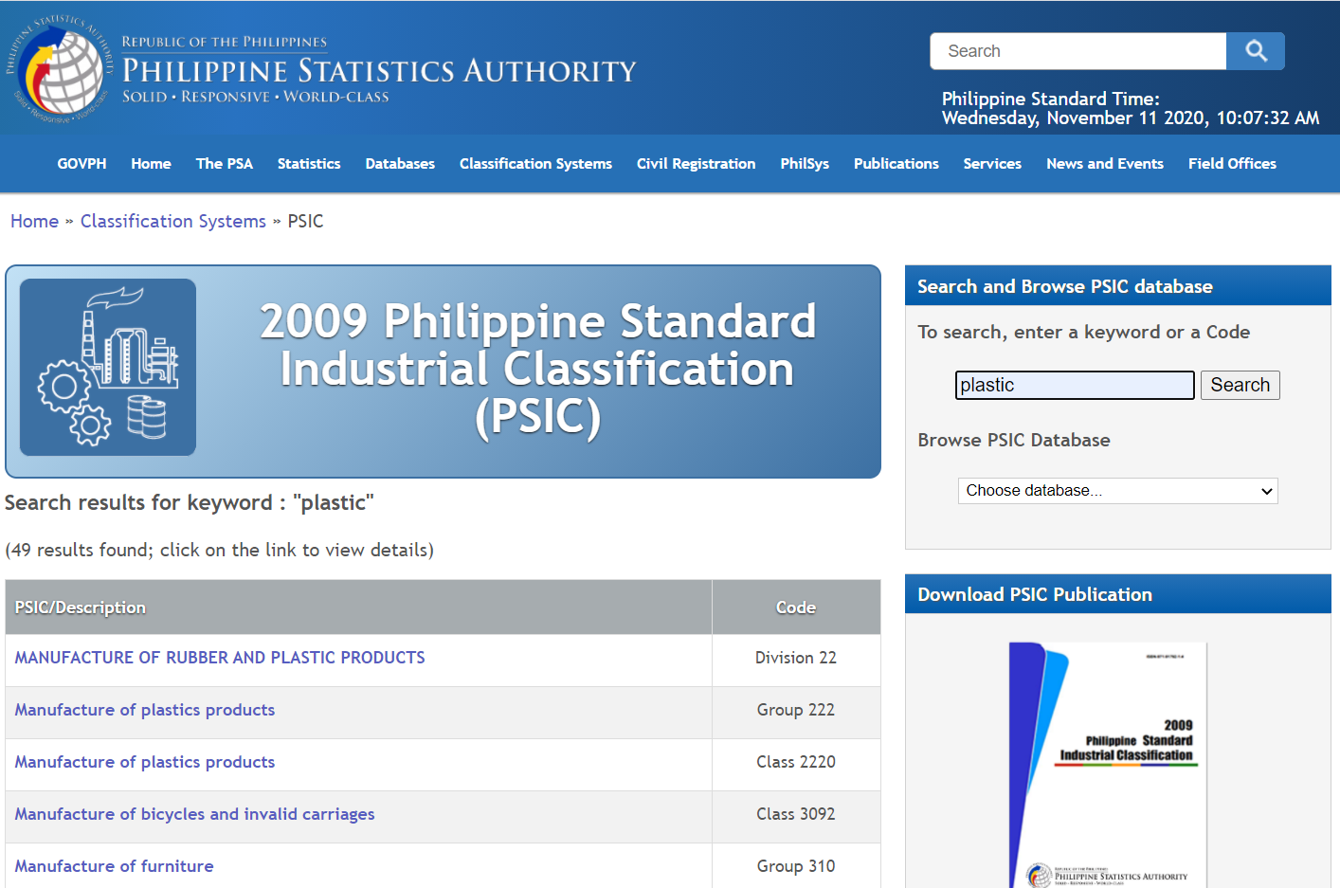
Select the Industry Code Based on the Supplier’s Business and Product
Step 1
1. Go to:
2. Enter the keyword to search for the code and select ‘search’
3. Select the code that best matches the product or service and record for later use
https://psa.gov.ph/classification/psic/

Slide 3
Identify Data Sources for Financial and Manufacturing Information Related to Industry Code
Step 2
National Statistics office of the Philippines:
Financial data of companies can be found at:
‘Additionally, we will use Economic Statistics from India as a proxy to help estimate DL & DM ratios
 | Direct Material (DM)
 | Direct Labor (DL)
 | Manufacturing Overhead (MOH)
 | Cost of Goods Sold (COGS)
 | GSA & Other Expenses
 | Profit Before Tax (PBT)
 | Total Sales
Manufacturing data
Source: National Statistics Office of the Philippines; Government of India
https://psa.gov.ph/
Financial data
Source: Financial reports of companies
www.sec.gov/edgar.shtml
*You will use these data sources to express DM, DL, MOH, COGS, GSA & Other Expenses and PBT as ratios, in the form of percentages of Total Sales.

Slide 4
Use Financial Data to Calculate Ratios for COGS, PBT, GSA & Other
Step 3
From each firms’ Income Statement, use multiple year averages to calculate COGS, GSA & Other Expenses and PBT.
Use as many firms as you judge necessary to get an accurate representation of the industry you are modelling.
Core Molding Technologies (CMT)*
 |  | 2020 | 2019 | 2018 | Average
 | COGS | 75.5% | 76.1% | 74.0% | 75.2%
 | GSA & Other | 18.4% | 18.6% | 19.1% | 18.7%
 | PBT | 6.1% | 5.3% | 6.9% | 6.1%
 | Total Sales | 100% | 100% | 100% | 100%
*Example firm operating in the Plastics Product Manufacturing Industry
$$COGS \%=\frac{COGS}{Total Sales}$$
$$PBT \%=\frac{PBT}{Total Sales}$$
GSA & O. Exp. % = Total sales (100%) – COGS % – PBT %

Slide 5
Use Financial Data to Calculate Ratios for COGS, PBT, GSA & Other
Step 3
Average the ratios of the selected firms to create your industry ratios.
Selected firms in Plastics product manufacturing industry*
 |  | Firm 1 | Firm 2 | … | Firm 7 | Average
 | COGS | 75% | 79% | … | 76% | 77.6%
 | GSA & Other | 19% | 17% | … | 19% | 17.8%
 | PBT | 6% | 4% | … | 5% | 4.6%
 | Total Sales | 100% | 100% | … | 100% | 100%
*Example data for illustration purposes only

Slide 6
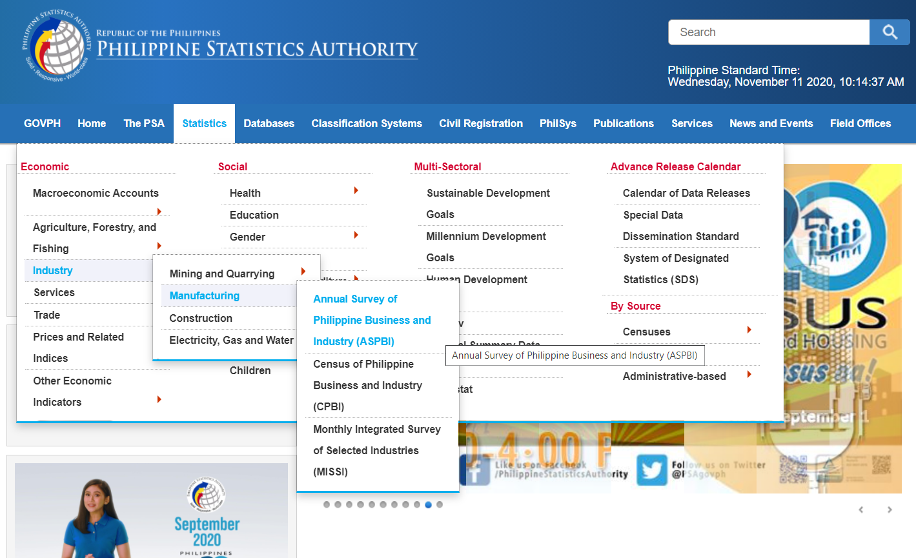
Use Manufacturing Data to Calculate Ratios for DM, DL, and MOH
Step 4
In the Philippines, follow 16 steps to find DM, DL, and MOH.
Step: 1
1. Go to:
And select: ‘Statistics → Industry → Manufacturing → Annual Survey of Philippine Business and Industry (ASPBI)’
https://psa.gov.ph/

Slide 7
Use Manufacturing Data to Calculate Ratios for DM, DL, and MOH
Step 4
2. Scroll down and click the most recent ‘2017 Annual Survey of Philippine Business and Industry (ASPBI) - Manufacturing Sector : Final Results’
3. Scroll down to the bottom, and under ‘Attachment’, select ‘Table 1’

Slide 8
Use Manufacturing Data to Calculate Ratios for DM, DL, and MOH
Step 4
4. Locate code C222
5. Extract Total Income and Compensation, and store for later use

Slide 9
Select the Industry Code Based on the Supplier’s Business and Product
Step 2
6. Go to
7. Click on “Microdata Catalog”
8. Search for “Annual Survey of Industries”
http://microdata.gov.in/nada43/index.php/home

Slide 10
Select the Industry Code Based on the Supplier’s Business and Product
Step 2
9. Click on “Datasets”
10. Search for the latest “Annual Survey of Industries” – in this case 2017-18

Slide 11
Select the Industry Code Based on the Supplier’s Business and Product
Step 2
11. Scroll down and click on “Nic_2008” to open the PDF file
12. In the PDF file, Use Control + F to search for keywords to locate the industry of interest and record the 4 digit respective NIC code for the industry of interest.

Slide 12
Use Financial and Manufacturing Information to Calculate Ratios
Step 3
13. On the same webpage, scroll up and look for “Annual Survey of Industries 2017-18 Volume – I”. Click on the pdf icon to access the latest publication of industry statistics

Slide 13
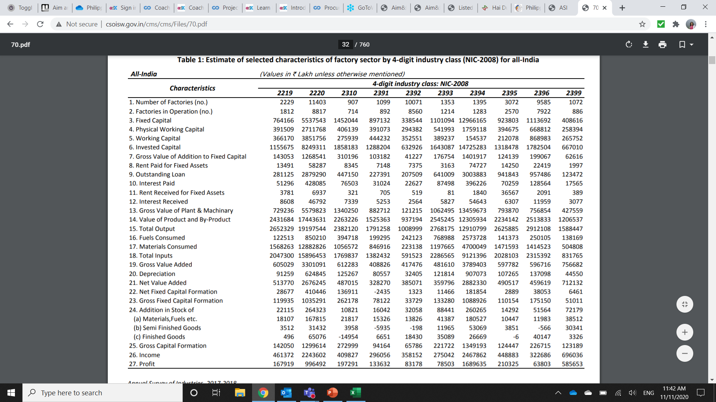
Use Manufacturing Data to Calculate Ratios for DM, DL, and MOH
Step 4
14.
In the PDF file, Scroll down to locate “Table 1: Estimate of selected characteristics of factory sector by 4-digit industry class (NIC – 2008) for all India”
Record the following values for NIC code 2220:
-15. Total Output
-17. Materials Consumed

Slide 14
Use Manufacturing Data to Calculate Ratios for DM, DL, and MOH
Step 4
15. Use the India Ministry of Statistics to calculate the Direct Labor to Total Labor ratio
See the procedure:
Calculating Direct to Total Labour Ratios

Slide 15
Use Manufacturing Data to Calculate Ratios for DM, DL, and MOH
Step 4
16. Calculate the DM ratio as percentage of Value of Output (We use this value for Total Sales)
 | Materials Consumed | 12,882,826
 | Value of Output | 19,197,544
 | Direct Material (DM) | 67.11%

Slide 16
Use Manufacturing Data to Calculate Ratios for DM, DL, and MOH
Step 4
17. Apply the Direct to Total Labor ratio to ‘total compensation’ to obtain an estimate of Direct Labor cost.
18. Use the Direct Labor cost to calculate the Direct Labor Ratio
 | Compensation (Philippines Statistic) | 11,192,548
 | Ratio of Direct to Total Labor | * 41.53%
 | Direct Labor | 4,648,100
 | Direct Labor | 4,648,100
 | Total Income | 118,954,297
 | Direct Labor % of Total Revenue | 3.91%

Slide 17
Use Manufacturing Data to Calculate Ratios for DM, DL, and MOH
Step 4
19. Calculate MOH by deduction as follows:
 | Cost of Goods Sold (COGS) | 77.6%
 | less Direct Material (DM) | 67.11%
 | less Direct Labor (DL) | 3.91%
 | Manufacturing Overhead (MOH) | 6.58%
MOH = COGS – DM –DL

Slide 18
Present all your calculated ratios in the cost breakdown format
Industry cost profile for “Plastics product manufacturing”
 | Direct Material (DM) | 67.11%
 | Direct Labor (DL) | 3.91%
 | Manufacturing Overhead (MOH) | 6.58%
 | Cost of Goods Sold (COGS) | 77.6%
 | GSA & Other Expenses | 17.8%
 | Profit Before Tax (PBT) | 4.6%
 | Total Sales | 100.0%
Ratios calculated from Philippines and India industry statistics
Ratios calculated from companies’ financial data

Slide 19
References and summary of ICP calculations
Cost Element | % of Sales | Calculation | Order
DM | 67.11% | = E / F | 4
DL | 3.91% | = (C * D) / G | 5
MOH | 6.58% | = COGS - DM - DL | 6
COGS | 77.6% | = A | 1
GSA | 17.8% | = Total - COGS - PBT | 3
PBT | 4.6% | = B | 2
TOTAL | 100.0%
SUMMARY OF DATA
 | Data point | Value | Source
A | Cost of Goods Sold | 67.11% | Average of representative firm's financials
B | Profit Before Tax | 4.6% | Average of representative firm's financials
C | Total Compensation | 11,192,548 | Annual survey of Philippines Business and Industry: PSIC C222
D | Direct Labor / Total Labor ratio | 41.53% | India Ministry of Statistics: NIC Code C2220
E | Materials Consumed | 12,882,826 | India Ministry of Statistics: NIC 2220
F | Value of Output | 19,197,544 | India Ministry of Statistics: NIC 2220
G | Total Income | 118,954,297 | Annual survey of Philippines Business and Industry: PSIC C222

